Slide 1
Data Collection
2024. 1. 10
SMEET LAB

Slide 2
Sensitivity Analysis
Why is Selecting variables important for DNN?
DNNs may not need to choose input variables because the coefficients of unnecessary variables will converge to zero.
However, selecting many variables increases the computation cost of estimation in the model
Also, It prevents the model from going into overfitting

Slide 3
Sensitivity Analysis
Sobol’s Method
Base Method : Decomposition of Variance
Advantage : Global Sensitivity, Interaction Effects, Non-linear Effects
Disadvantage : Computational Intensity, Model dependent
Boruta
Base Method : Random Forest
Advantage : Robustness
Disadvantage : Randomness, Computational Intensity, Focus on Feature Selection

Slide 4
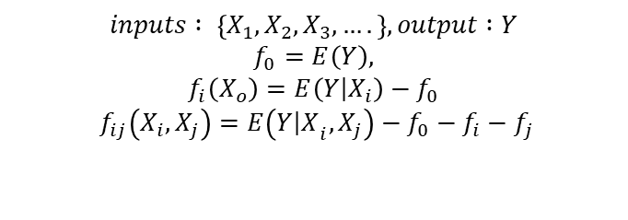
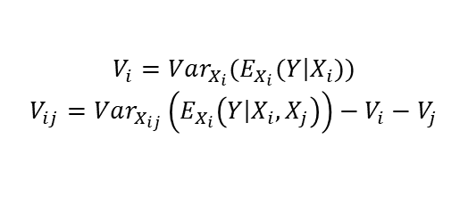
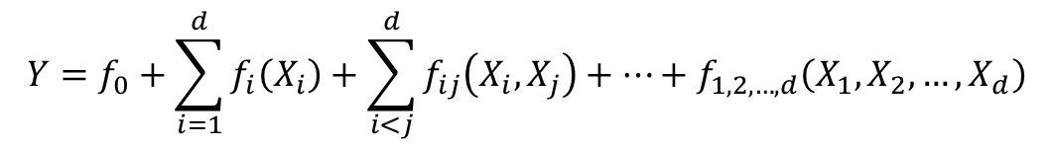

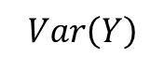
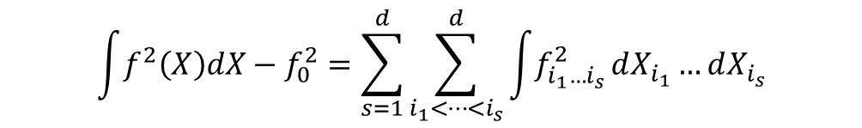
Sobol’s Method
Decomposition of Varaince
$$Y=f_{0}+\sum_{i=1}^{d}{f_{i}\left(X_{i}\right)}+\sum_{i<j}^{d}{f_{ij}\left(X_{i},X_{j}\right)}+⋯+f_{1,2,…,d}\left(X_{1},X_{2},…,X_{d}\right)$$
$$inputs : \left\{X_{1},X_{2},X_{3},….\right\}, output :Y$$
$$f_{0}=E\left(Y\right),$$
$$f_{i}\left(X_{o}\right)=E\left(\left.Y\right|X_{i}\right)−f_{0}$$
$$f_{ij}\left(X_{i},X_{j}\right)=E\left(Y{\left|X\right.}_{i},X_{j}\right)−f_{0}−f_{i}−f_{j}$$
Assume f is square-integrable
$$\int{f^{2}\left(X\right)dX}−f_{0}^{2}=\sum_{s=1}^{d}{\sum_{i_{1}<…<i_{s}}^{d}{\int{f_{i_{1}…i_{s}}^{2}}}}dX_{i_{1}}…dX_{i_{s}}$$
$$\sum_{i=1}^{d}{V_{i}}+\sum_{i<j}^{d}{V_{ij}}+⋯+V_{12…d}$$
$$V_{i}=Var_{X_{i}}(E_{X_{i}}(\left.Y\right|X_{i}))$$
$$V_{ij}=Var_{X_{ij}}\left(E_{X_{i}}\left(\left.Y\right|X_{i},X_{j}\right)\right)−V_{i}−V_{j}$$
$$Var\left(Y\right)$$

Slide 5


Sobol’s Method
First – order indices
The effect of single variable
Total-effect index
The effect of single variable and all intersections
$$S_{i}=\frac{V_{i}}{Var(Y)}=\frac{Var_{X_{i}}(E_{X_{i}}(Y∣x_{\sim i}))}{Var(Y)}$$
$$S_{i}=1−\frac{Var(Var_{X_{i}}(Y∣x_{\sim i}))}{Var(Y)}$$

Slide 6
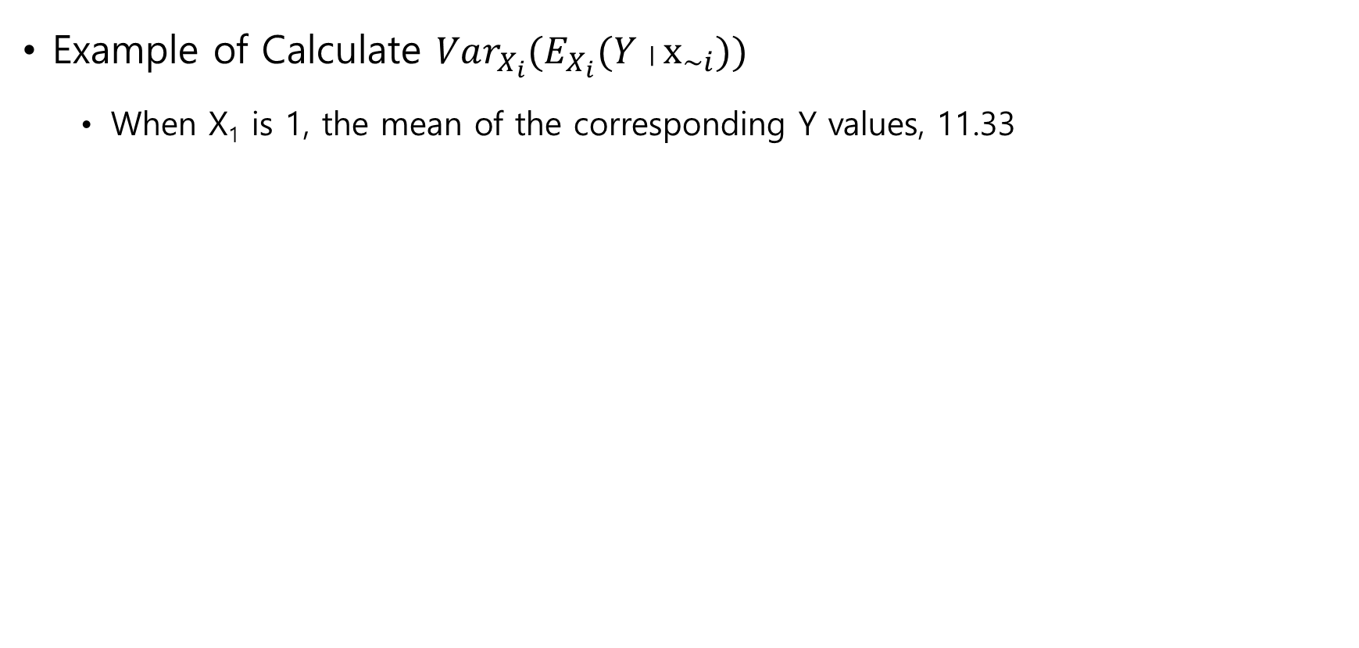
Sobol’s Method
Example of Calculate $Var_{X_{i}}(E_{X_{i}}(Y∣x_{\sim i}))$
When X₁ is 1, the mean of the corresponding Y values, 11.33
X₁ | X₂ | X₃ | Y
1 | 2 | 3 | 10
1 | 3 | 1 | 11
1 | 4 | 5 | 13
2 | 2 | 2 | 15
2 | 3 | 1 | 14
2 | 1 | 4 | 16
… | … | … | …

Slide 7
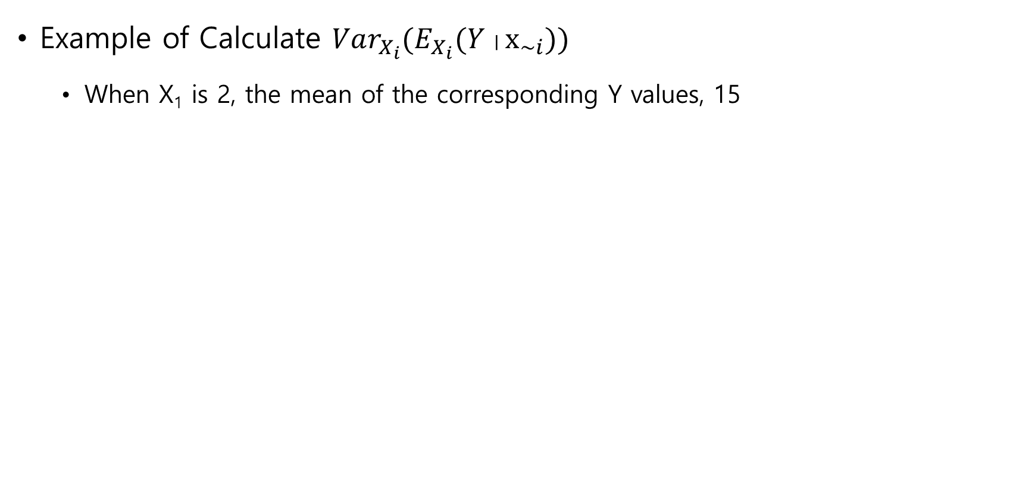
Sobol’s Method
Example of Calculate $Var_{X_{i}}(E_{X_{i}}(Y∣x_{\sim i}))$
When X₁ is 2, the mean of the corresponding Y values, 15
X₁ | X₂ | X₃ | Y
1 | 2 | 3 | 10
1 | 3 | 1 | 11
1 | 4 | 5 | 13
2 | 2 | 2 | 15
2 | 3 | 1 | 14
2 | 1 | 4 | 16
… | … | … | …

Slide 8
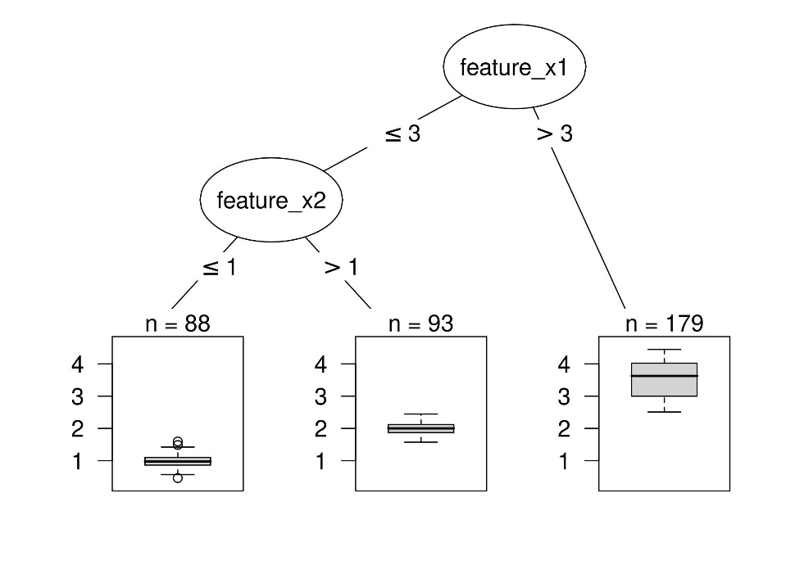
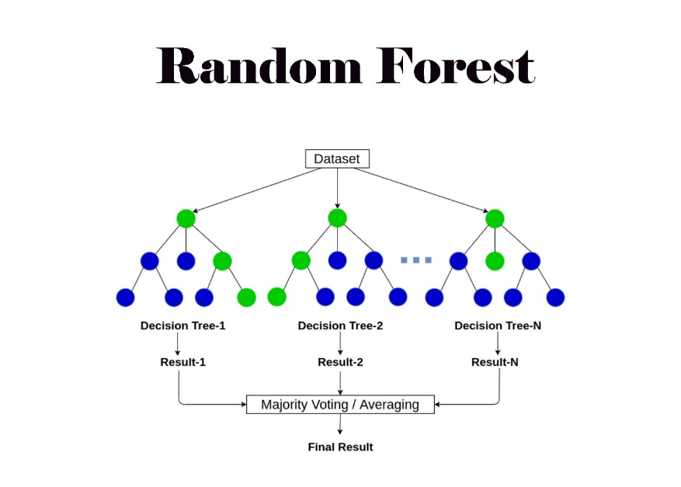
Boruta
Decision Tree
It’s kind of a guessing game
Random Forest
Decision Tree + Ensemble
Ensemble

Slide 9
Boruta
Boruta method
Added shadow variables
Train Random Forest
Extract Importances
Determine the values that lower importance than shadow variables
Repeat this

Slide 10
Boruta
Method
Use Boruta
Visualization the select data
Variables
Gathering data using Carmaker
Data is gathered by sensor data and control data that can achieve
Sensor data : data from IMU, wheel speed sensor
Control data : steering angle, motor torque

Slide 11
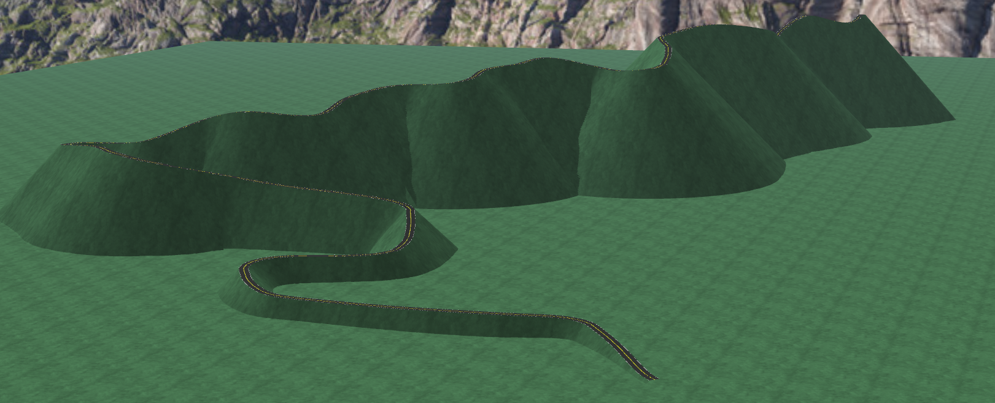
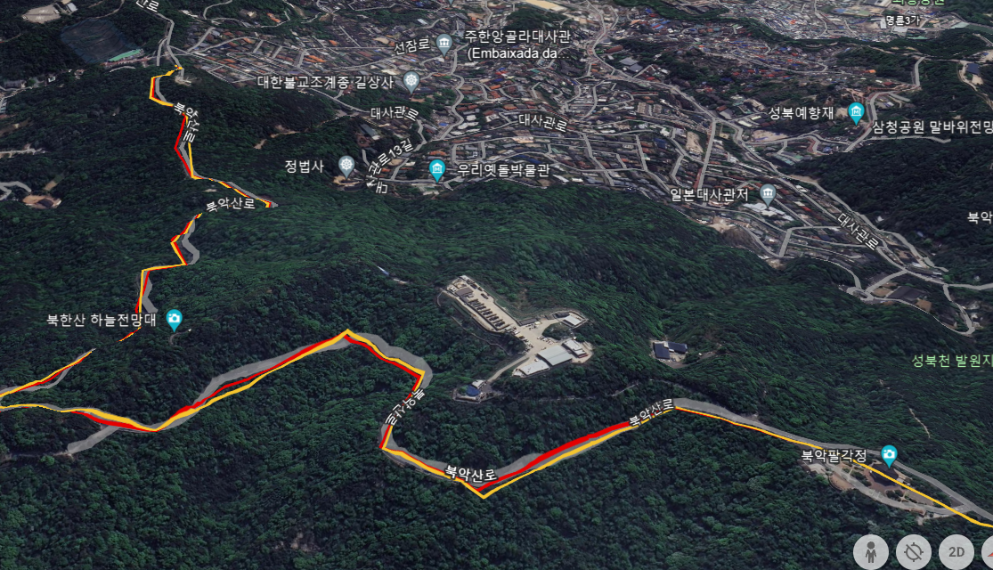
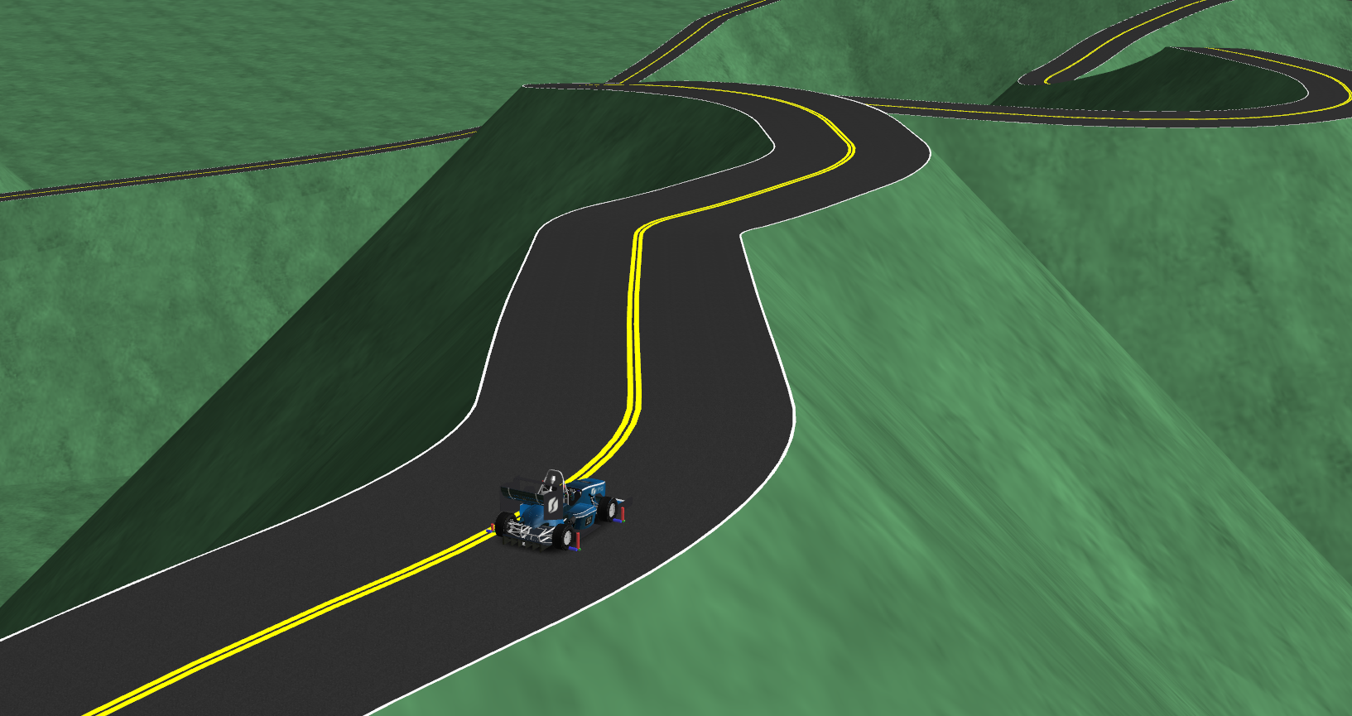
Carmaker
For various environments
Make a new Map
North skyway Road

Slide 12
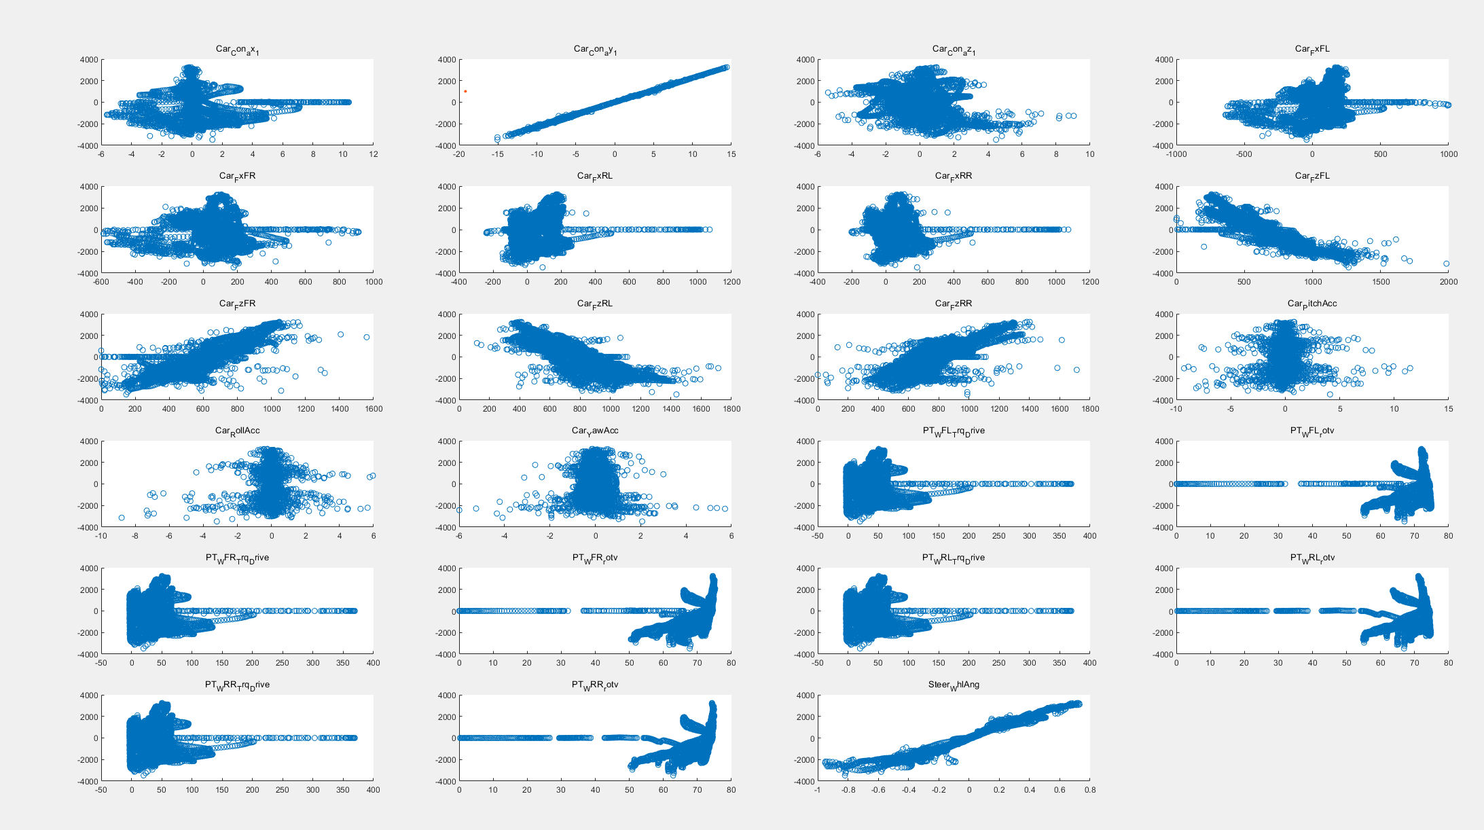
Carmaker

Slide 13
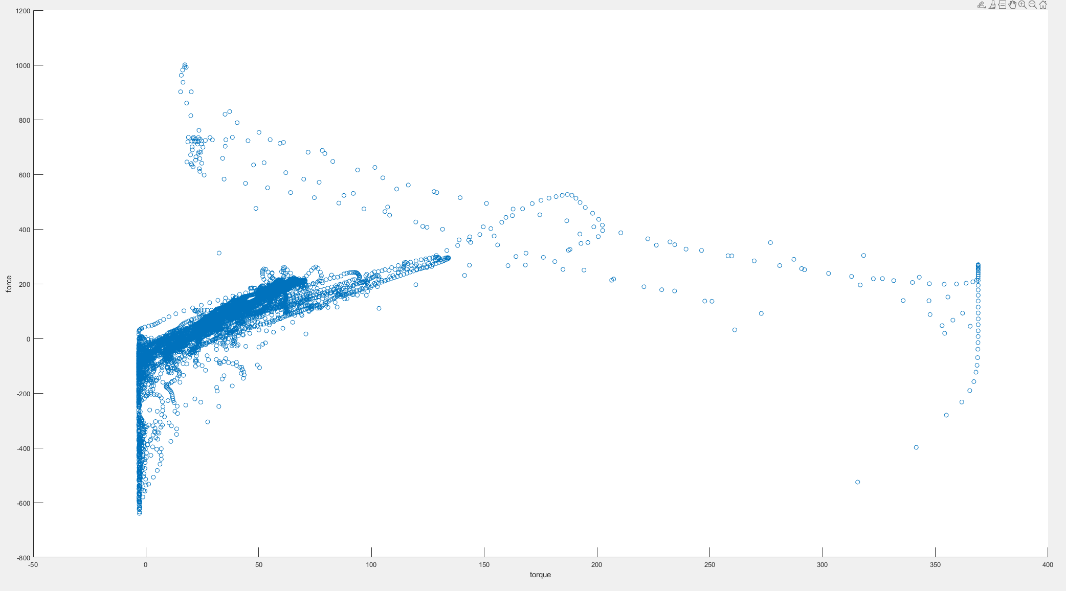
Carmaker
Fx is plotted against Motor Torque

Slide 14
Carmaker
The Result of Boruta method
Iteration : 100
Variable | hints | importance | Variable | hints | importance
Car.Con.ax_1 | 5 | 3.22E-06 | Car.PitchAcc | 16 | 1.25E-05
Car.Con.ay_1 | 100 | 99.99962 | Car.RollAcc | 34 | 2.65E-05
Car.Con.az_1 | 8 | 5.99E-06 | Car.YawAcc | 3 | 1.25E-06
Car.FxFL | 0 | 5.9E-07 | PT.WFL.Trq_Drive | 0 | 0
Car.FxFR | 2 | 2.47E-06 | PT.WFL.rotv | 0 | 0
Car.FxRL | 9 | 7.37E-06 | PT.WFR.Trq_Drive | 0 | 0
Car.FxRR | 15 | 9.29E-06 | PT.WFR.rotv | 16 | 1.5E-05
Car.FzFL | 45 | 2.01E-05 | PT.WRL.Trq_Drive | 0 | 0
Car.FzFR | 2 | 4.04E-07 | PT.WRL.rotv | 1 | 1.86E-07
Car.FzRL | 24 | 2.06E-05 | PT.WRR.Trq_Drive | 1 | 5.11E-07
Car.FzRR | 35 | 2.88E-05 | PT.WRR.rotv | 52 | 0.000168
Steer.WhlAng | 22 | 4.9E-05

